Slide 1
Time series analysis
Angel Marchev, Jr.
Kaloyan Haralampiev

Slide 2
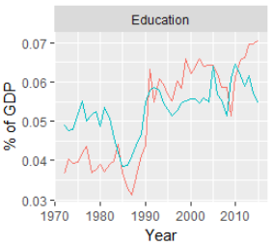
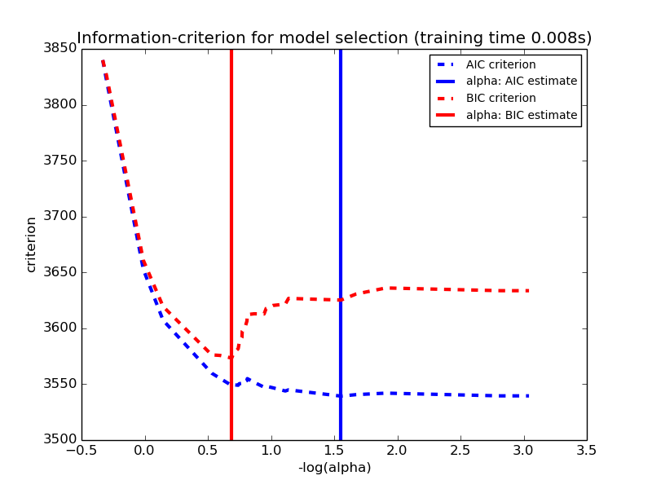
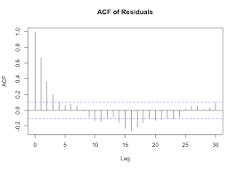
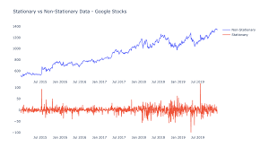
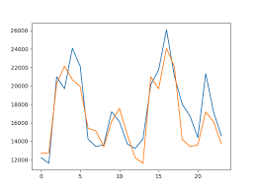
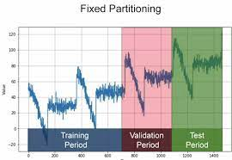
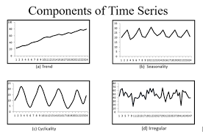
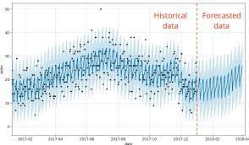
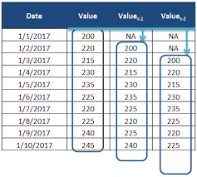
Key topics
Comparability
Stationarity
Components
Autocorrelation
Models
Feature engineering
Optimization
Validation
Forecast

Slide 3
Comparability
Basic
Additional
By territory
By time
By methodology
By prices
By coverage
By measurement units

Slide 4
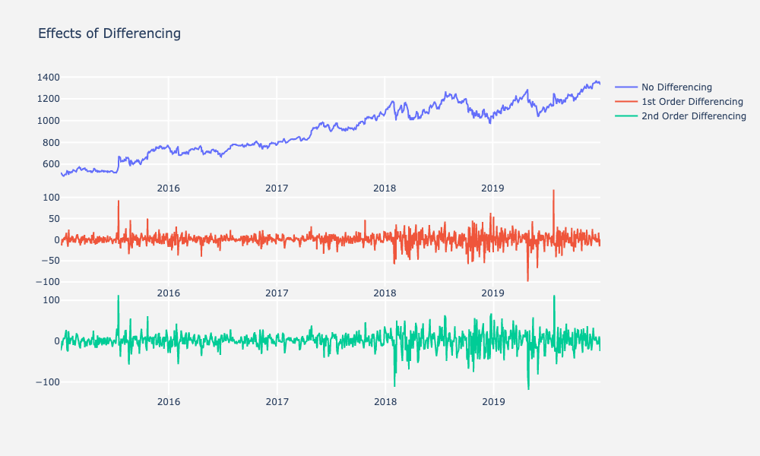
Stationarity
Constant distribution
i.e.
Constant mean
Constant variance
etc…

Slide 5
Components of dynamics
Trend
Cycle
Seasonality
Noise

Slide 6
Trend

Slide 7
Cycle

Slide 8
Seasonality

Slide 9

Autocorrelation
Autocorrelation function (ACF)
$$R_{y_{t},y_{t−i}}$$
Partial autocorrelation function (PACF)
$$R_{y_{t},y_{t−i}|y_{t−j}}, j<i$$

Slide 10

Main models
Regression
$${\hat{y}}_{t}=f(t)$$
$${\hat{y}}_{t}=f(t,x)$$
Autoregression
$${\hat{y}}_{t}=f\left(y_{t−i}\right)$$
$${\hat{y}}_{t}=f\left(y_{t−i}, x_{t−j}\right)$$
Mixed models of regression and autoregression
$${\hat{y}}_{t}=f({t,y}_{t−i}, x_{t−j})$$

Slide 11
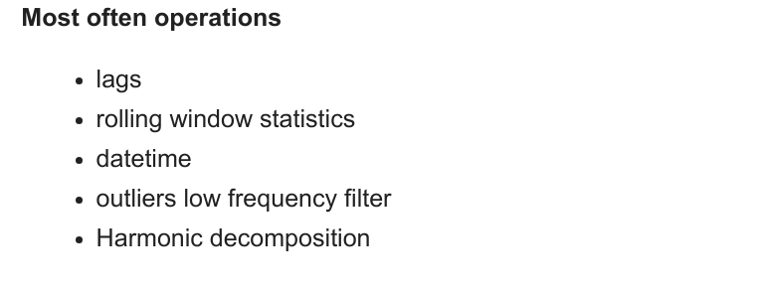
Feature engineering

Slide 12
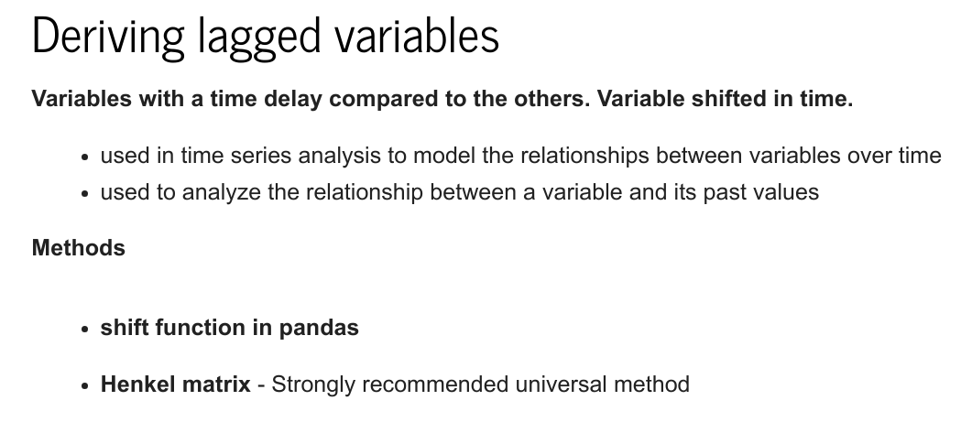

Slide 13
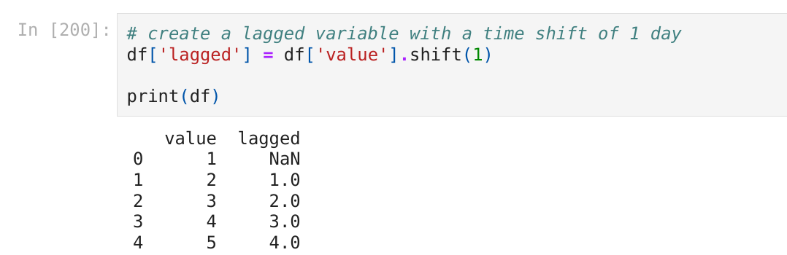
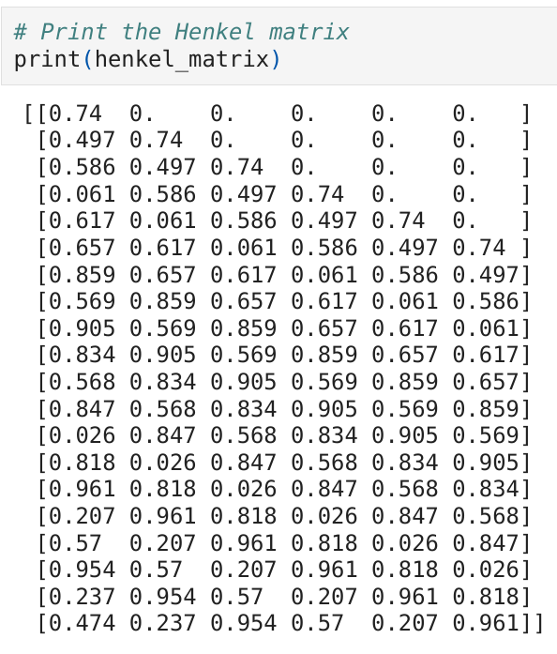
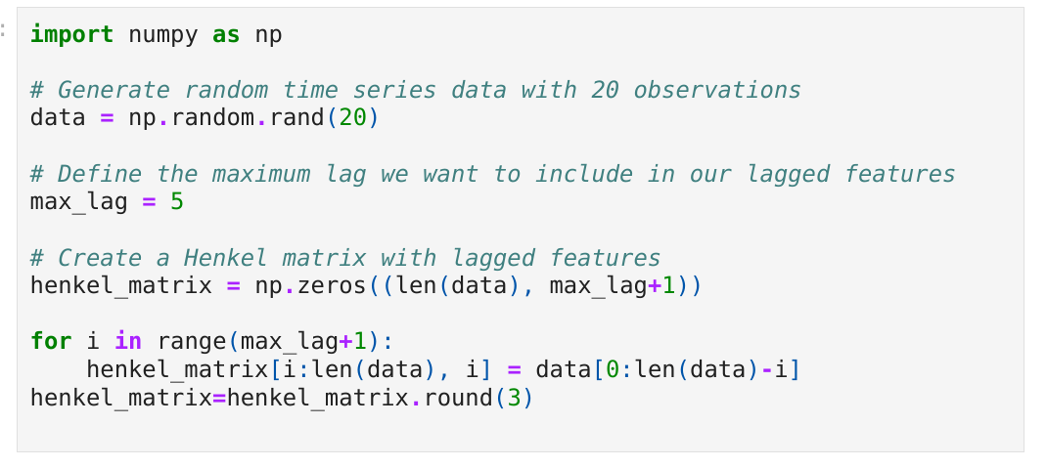

Slide 14
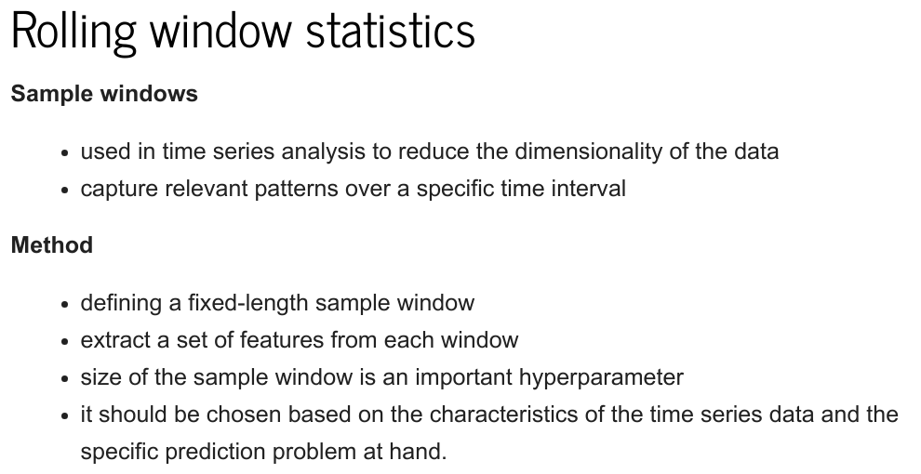

Slide 15
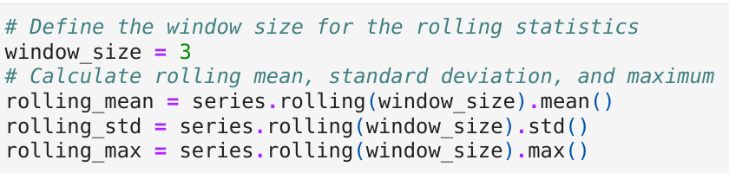
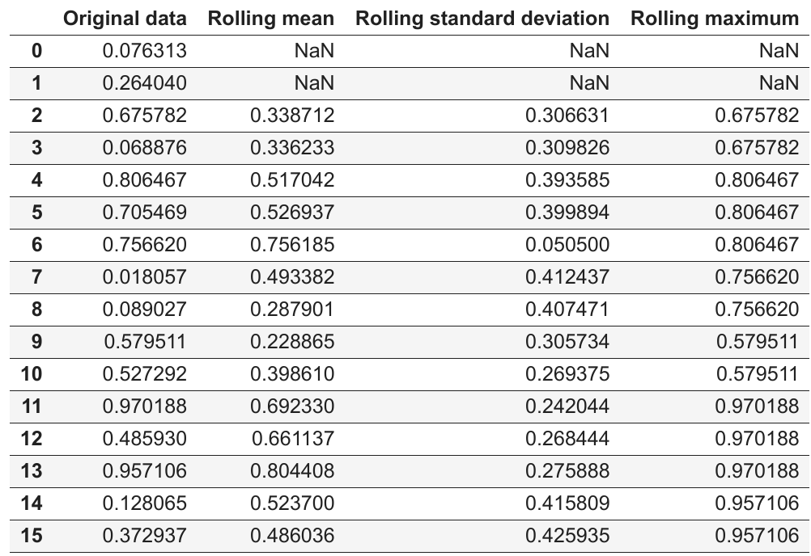

Slide 16
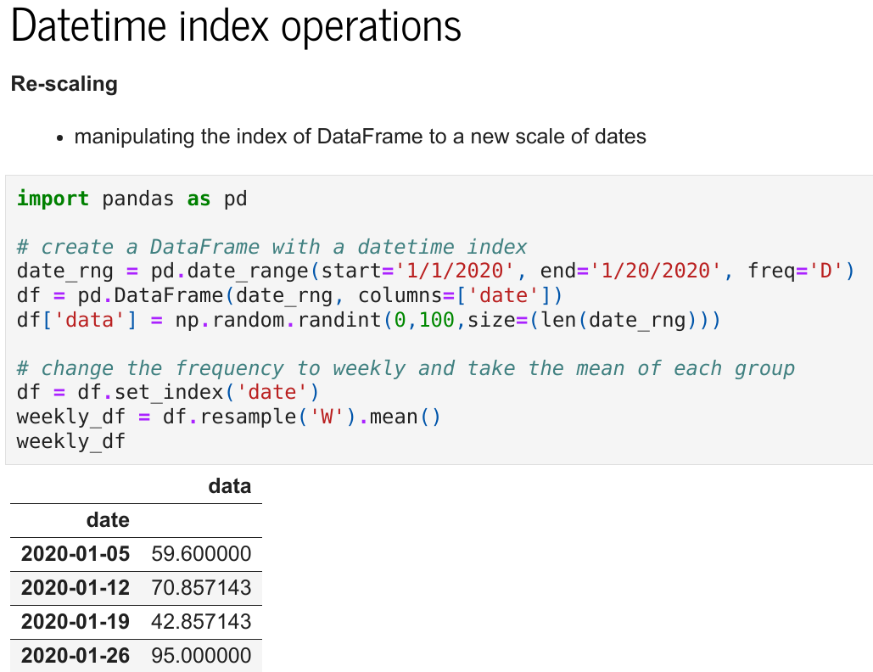

Slide 17
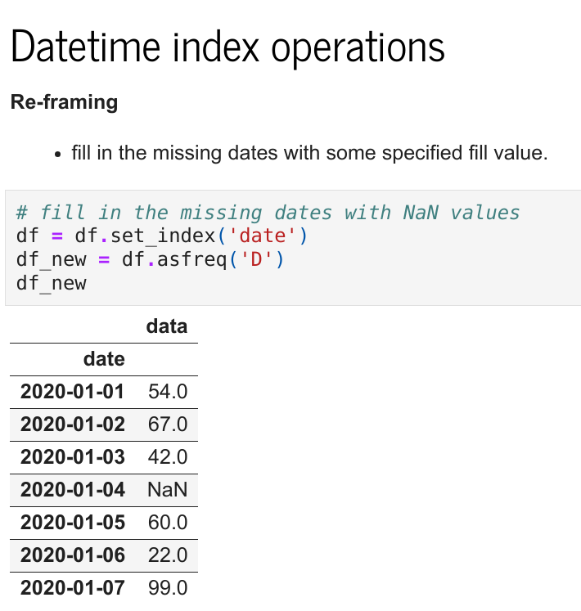

Slide 18
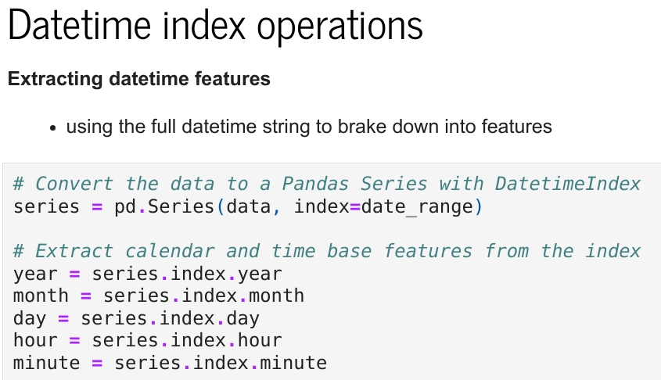
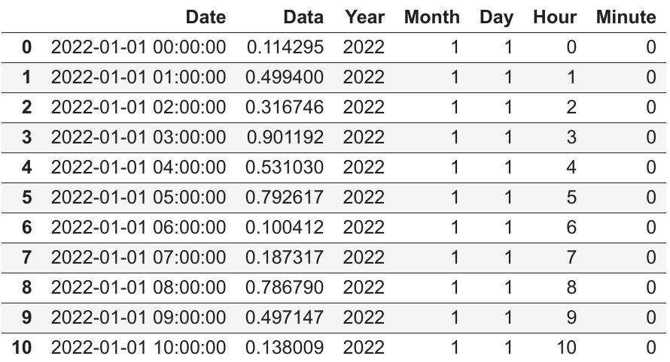

Slide 19
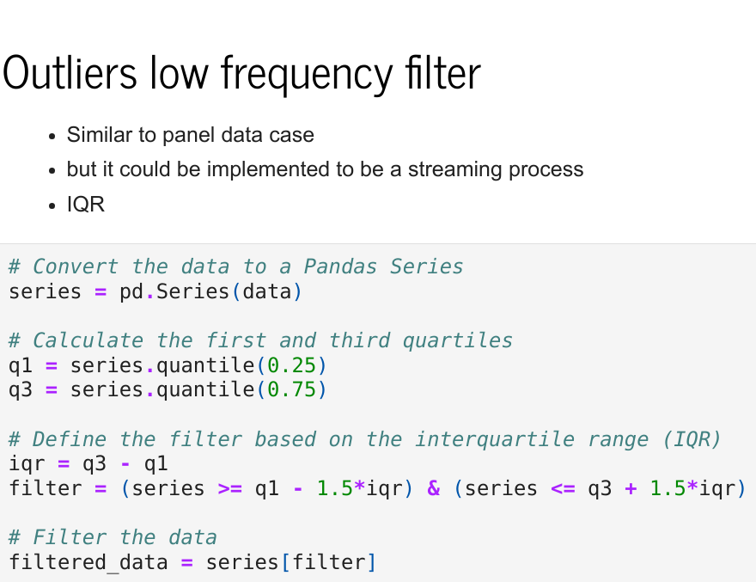
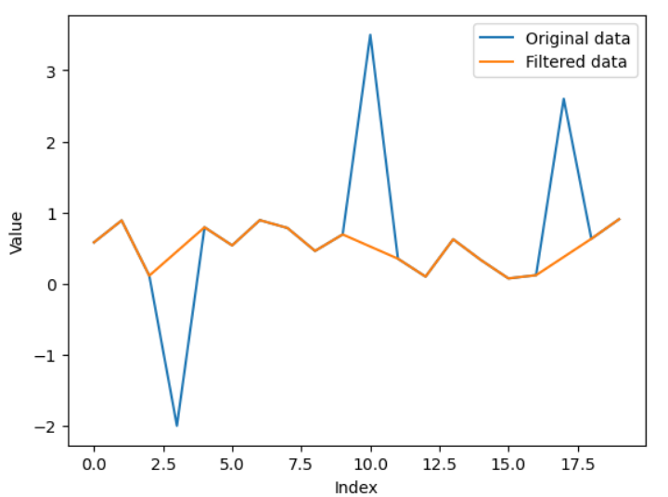

Slide 20
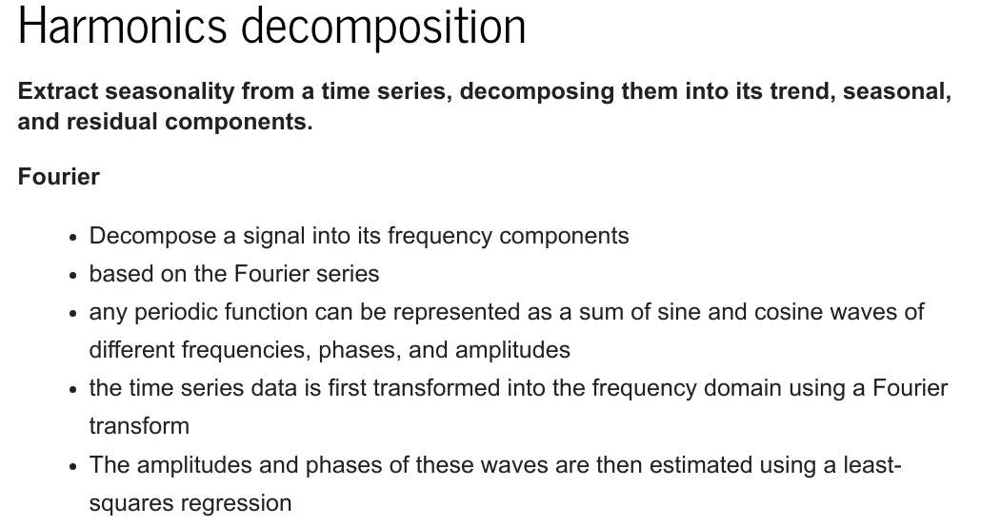

Slide 21
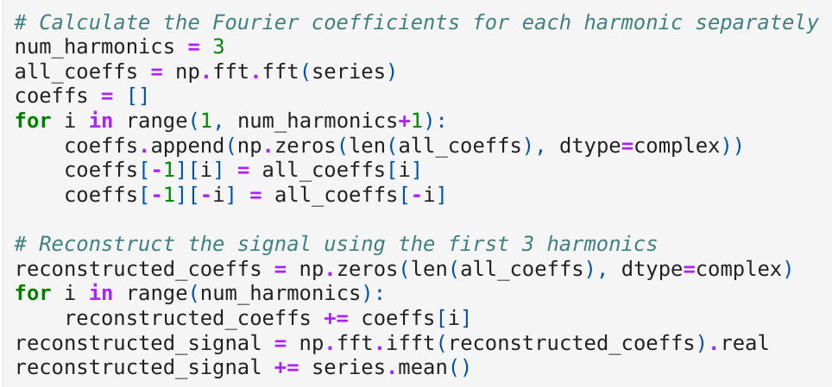
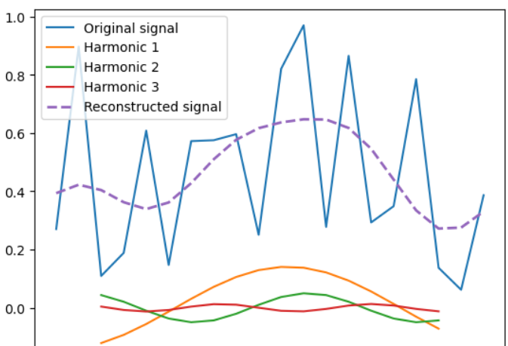

Slide 22
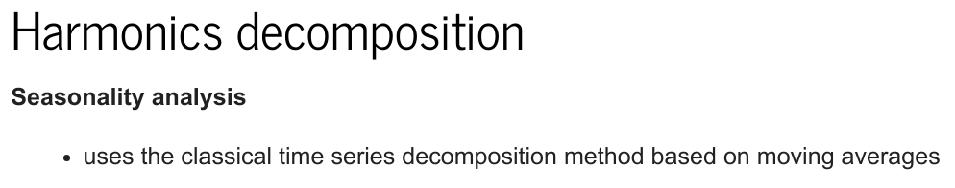
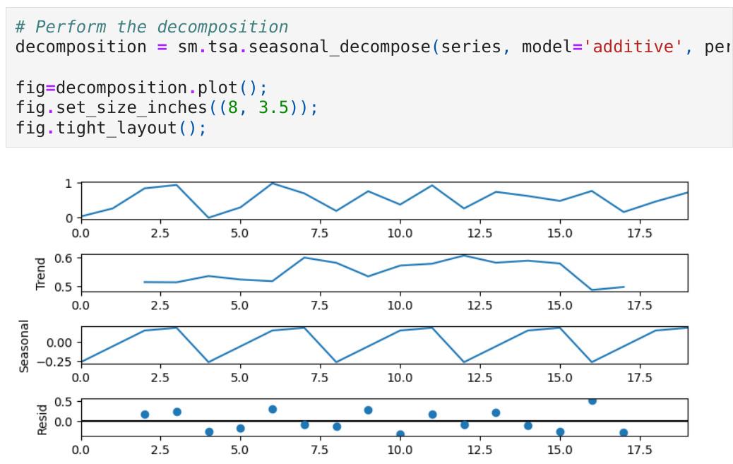

Slide 23
Approaches for estimation of coefficients
Analytical
Ordinary least squares (OLS)
Maximum likelihood (ML)
Bayesian
Iterative…
but…
All of these are in fact optimization

Slide 24
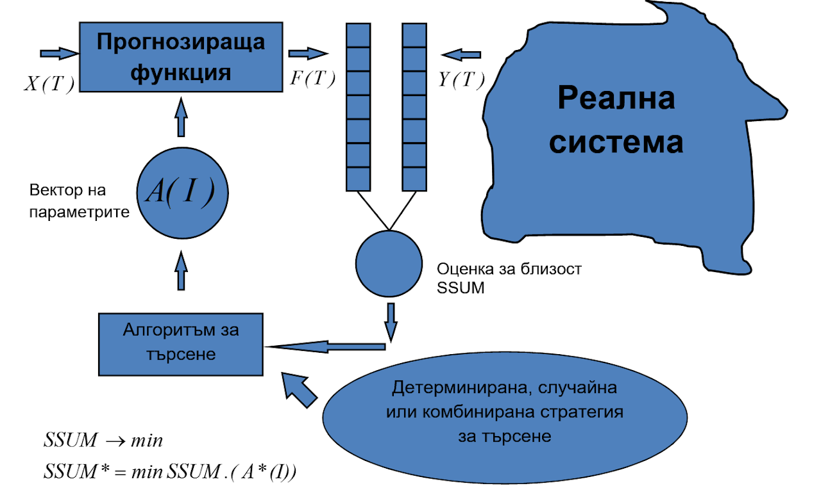
Optimization

Slide 25

Overfitting
$$y_{i}=m_{i}+ε_{i}$$
$$y_{i}=m_{i}+\underset{ε_{i}}{\underbrace{ε_{i}^{′}+ε_{i}^{′′}}}=\underset{m_{i}^{′}}{\underbrace{m_{i}+ε_{i}^{′}}}+ε_{i}^{′′}=m_{i}^{′}+ε_{i}^{′′}$$

Slide 26
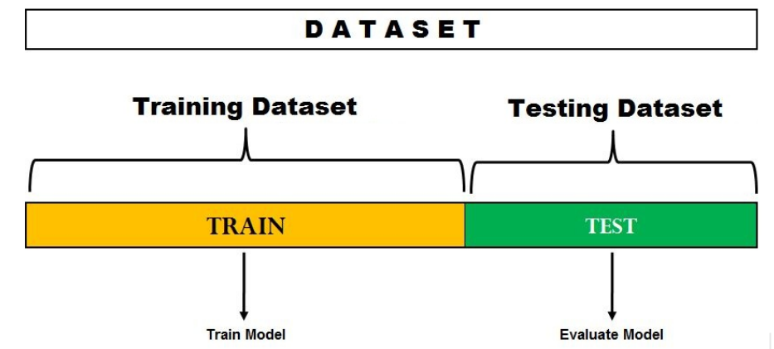
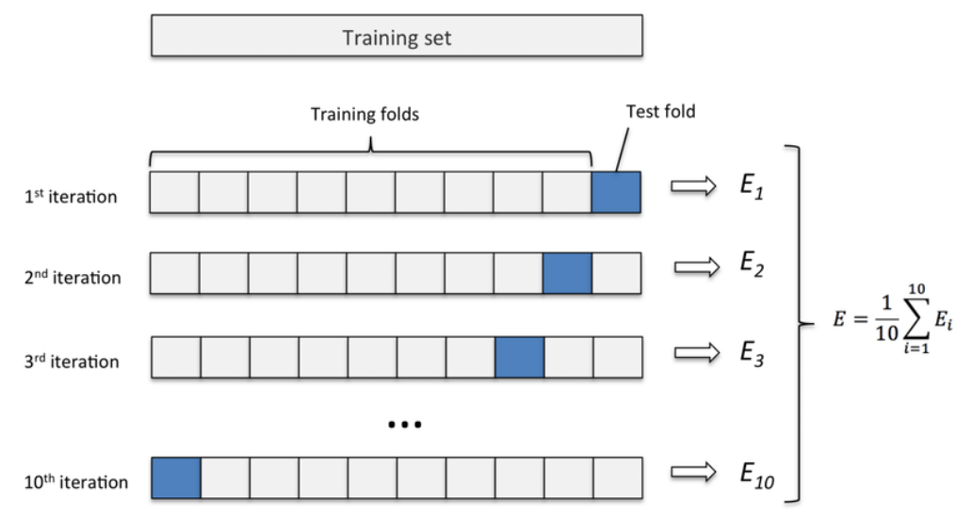
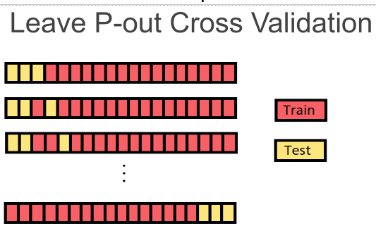
Validation
Split sample validation
Training set
Test set
Validation subset/method

Slide 27
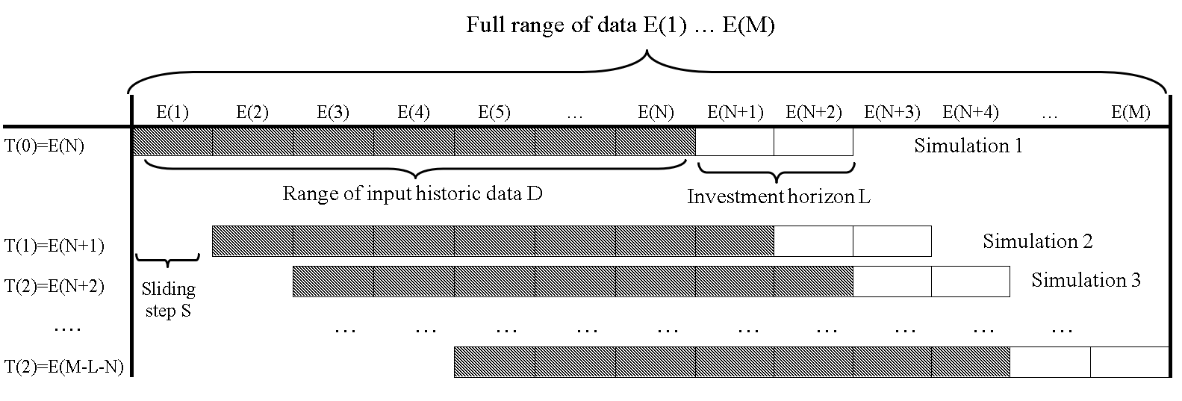
Validation
Validation with moving window

Slide 28
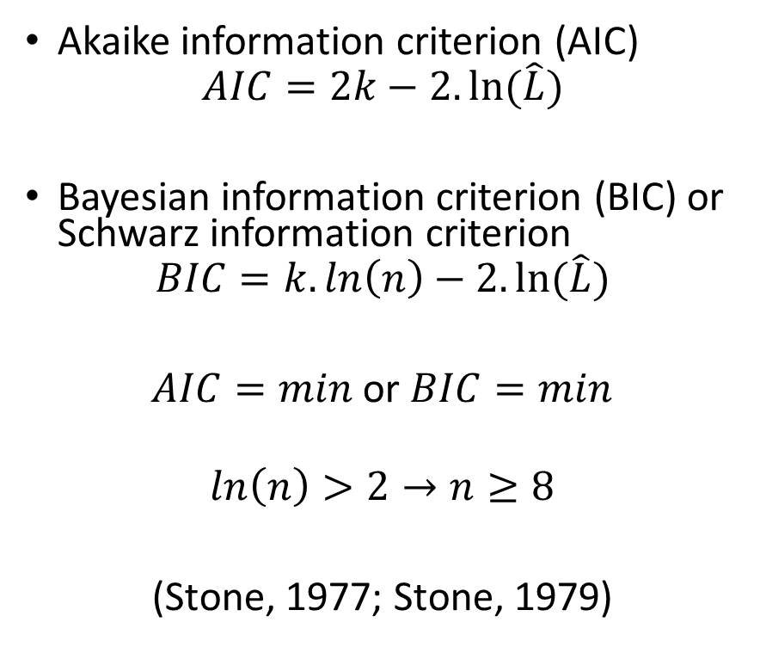
Information criteria
Akaike information criterion (AIC)
$$AIC=2k−2.ln⁡(\hat{L})$$
Bayesian information criterion (BIC) or Schwarz information criterion
$$BIC=k.ln\left(n\right)−2.ln⁡(\hat{L})$$
$AIC=min$ or $BIC=min$
$$\ln\left(n\right)>2→n≥8$$
(Stone, 1977; Stone, 1979)

Slide 29
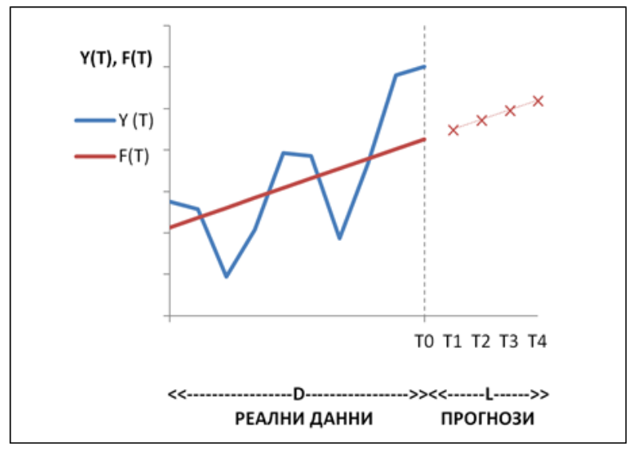
Forecasts
Extrapolation/interpolation
Analytical forecasts
Target forecasts

Slide 30
Forecast horizon
Short term, medium term, long term
Depending of time series length

Slide 31
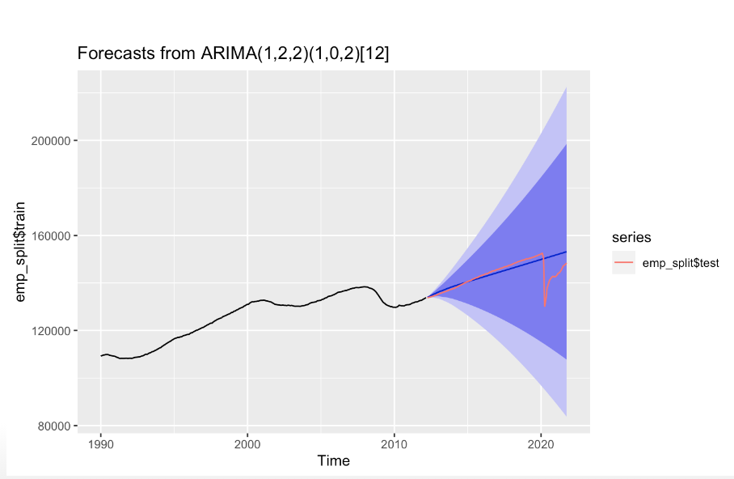
Confidence interval of forecast

Slide 32
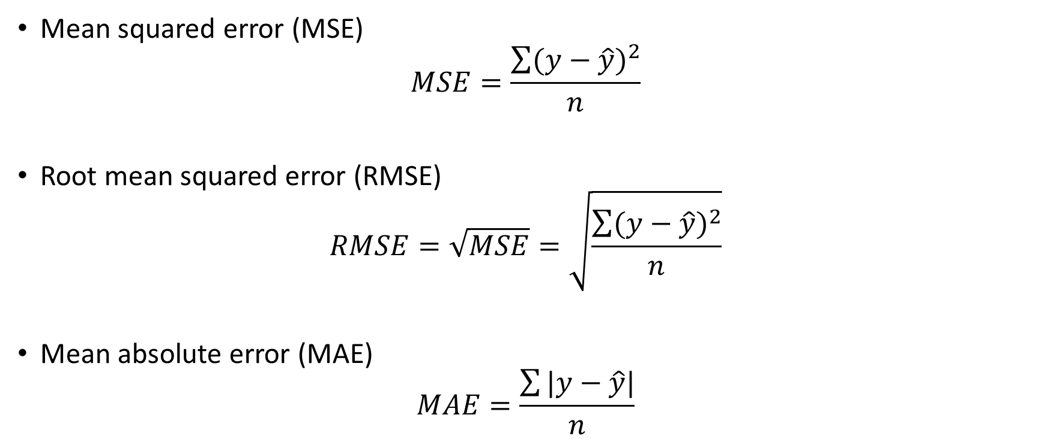
Evaluation of forecast
Mean squared error (MSE)
$$MSE=\frac{\sum{{(y−\hat{y})}^{2}}}{n}$$
Root mean squared error (RMSE)
$$RMSE=\sqrt{MSE}=\sqrt{\frac{\sum{{(y−\hat{y})}^{2}}}{n}}$$
Mean absolute error (MAE)
$$MAE=\frac{\sum{|y−\hat{y}|}}{n}$$

Slide 33
Bayesian periodogram analysis

Slide 34
Bayesian estimation of model coefficients
$$y_{i}=f\left(t_{i}\right)+ε_{i}$$
$$P\left(a_{k} | DI\right)=\frac{P\left(D | a_{k}I\right)P\left(a_{k} | I\right)}{\sum_{l=1}^{m}{\left[P\left(D | a_{l}I\right)P\left(a_{l} | I\right)\right]}}$$
$$P\left(a_{k} | I\right)=\prod_{l=1}^{m}{P\left(a_{l} | I\right)}=const$$
$$P\left(a_{k} | DI\right)=\frac{P\left(D | a_{k}I\right).const}{\sum_{l=1}^{m}{\left[P\left(D | a_{l}I\right).const\right]}}=\frac{P\left(D | a_{k}I\right)}{\sum_{l=1}^{m}{P\left(D | a_{l}I\right)}}∝P\left(D | a_{k}I\right)$$

Slide 35
Bayesian estimation of model coefficients
$$P\left(D | a_{k}I\right)=\prod_{i=1}^{n}{\left[\frac{1}{\sqrt{2πσ^{2}}}e^{−\frac{{(ε_{i}−0)}^{2}}{2σ^{2}}}\right]}=\frac{1}{{\left(\sqrt{2πσ^{2}}\right)}^{n}}e^{−\frac{\sum_{i=1}^{n}{ε_{i}^{2}}}{2σ^{2}}}$$
$$σ^{2}=\frac{\sum_{i=1}^{n}{{(ε_{i}−0)}^{2}}}{n}=\frac{\sum_{i=1}^{n}{ε_{i}^{2}}}{n}$$
$$P\left(D | a_{k}I\right)=\frac{1}{{\left(\sqrt{2π\frac{\sum_{i=1}^{n}{ε_{i}^{2}}}{n}}\right)}^{n}}e^{−\frac{\sum_{i=1}^{n}{ε_{i}^{2}}}{2\frac{\sum_{i=1}^{n}{ε_{i}^{2}}}{n}}}=\frac{1}{{\left(\sqrt{2π\frac{\sum_{i=1}^{n}{ε_{i}^{2}}}{n}}\right)}^{n}}e^{−\frac{n}{2}}$$

Slide 36

Bayesian estimation of model coefficients
$$P\left(a_{k} | DI\right)=max→P\left(D | a_{k}I\right)=max$$
$$\left|\frac{dP\left(D | a_{k}I\right)}{da_{k}}=0\right.$$
$$\left|\sum_{i=1}^{n}{\left[y_{i}\frac{df\left(t_{i}\right)}{da_{k}}\right]}=\sum_{i=1}^{n}{\left[f\left(t_{i}\right)\frac{df\left(t_{i}\right)}{da_{k}}\right]}\right.$$

Slide 37
Bayesian estimation of model coefficients
$$P\left(D | a_{k}I\right)=\frac{1}{{\left(\sqrt{2πσ^{2}}\right)}^{n}}e^{−\frac{\sum_{i=1}^{n}{ε_{i}^{2}}}{2σ^{2}}}=\frac{1}{{\left(\sqrt{2πσ^{2}}\right)}^{n}}e^{−\frac{nσ^{2}}{2σ^{2}}}=\frac{1}{{\left(\sqrt{2πσ^{2}}\right)}^{n}}e^{−\frac{n}{2}}=\frac{1}{{\left(\sqrt{2π{eσ}^{2}}\right)}^{n}}$$
$$BIC=m.\ln\left(n\right)−2.ln\frac{1}{{\left(\sqrt{2π{eσ}^{2}}\right)}^{n}}=m.\ln\left(n\right)−2.ln{\left(2π{eσ}^{2}\right)}^{−\frac{n}{2}}=m.\ln\left(n\right)+n.ln(2π{eσ}^{2})$$

Slide 38

Series
Taylor
$$f\left(x\right)=\sum_{j=0}^{∞}{\frac{f^{\left(j\right)}(a)}{j!}{(x−a)}^{j}}$$
Maclaurin
$$f\left(x\right)=\sum_{j=0}^{∞}{\frac{f^{\left(j\right)}(0)}{j!}x^{j}}$$
Fourier
$${f\left(x\right)=a}_{0}+\sum_{j=1}^{∞}{\left(a_{j}cos\frac{2πj}{n}x+b_{j}sin\frac{2πj}{n}x\right)}$$

Slide 39
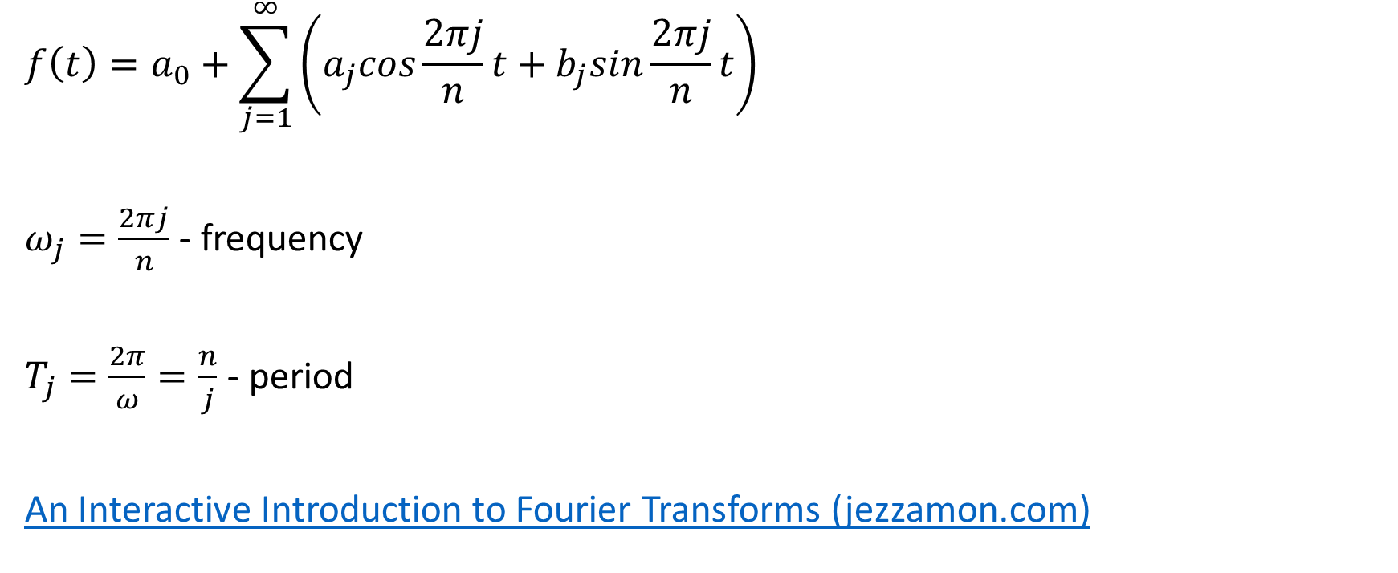
Periodogram analysis
$$f\left(t\right)=a_{0}+\sum_{j=1}^{∞}{\left(a_{j}cos\frac{2πj}{n}t+b_{j}sin\frac{2πj}{n}t\right)}$$
$ω_{j}=\frac{2πj}{n}$ - frequency
$T_{j}=\frac{2π}{ω}=\frac{n}{j}$ - period
An Interactive Introduction to Fourier Transforms (jezzamon.com)

Slide 40
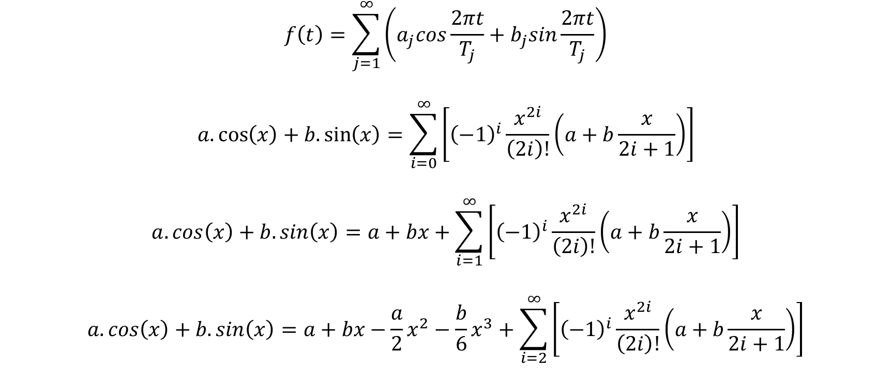
Bayesian periodogram analysis
$$f\left(t\right)=\sum_{j=1}^{∞}{\left(a_{j}cos\frac{2πt}{T_{j}}+b_{j}sin\frac{2πt}{T_{j}}\right)}$$
$$a.\cos\left(x\right)+b.\sin\left(x\right)=\sum_{i=0}^{∞}{\left[{\left(−1\right)}^{i}\frac{x^{2i}}{\left(2i\right)!}\left(a+b\frac{x}{2i+1}\right)\right]}$$
$$a.\cos\left(x\right)+b.\sin\left(x\right)=a+bx+\sum_{i=1}^{∞}{\left[{\left(−1\right)}^{i}\frac{x^{2i}}{\left(2i\right)!}\left(a+b\frac{x}{2i+1}\right)\right]}$$
$$a.\cos\left(x\right)+b.\sin\left(x\right)=a+bx−\frac{a}{2}x^{2}−\frac{b}{6}x^{3}+\sum_{i=2}^{∞}{\left[{\left(−1\right)}^{i}\frac{x^{2i}}{\left(2i\right)!}\left(a+b\frac{x}{2i+1}\right)\right]}$$

Slide 41
Approximation of linear function

Slide 42
Approximation of quadratic function

Slide 43
Approximation of cubic function

Slide 44

Components of dynamics
If $T_{j}>t_{n}−t_{1}+1→Trend$
If $T_{j}<\frac{2}{3}\left(t_{n}−t_{1}+1\right)→Cycle$
If$\frac{2}{3}\left(t_{n}−t_{1}+1\right)<T_{j}<t_{n}−t_{1}+1→Grey zone (insufficient data)$
If $T_{j}≤12 months →Seasonality$

Slide 45

Bayesian periodogram analysis
$$f\left(t\right)=\sum_{j=1}^{∞}{\left(a_{j}cos\frac{2πt}{T_{j}}+b_{j}sin\frac{2πt}{T_{j}}\right)}$$
$$f\left(t\right)=\sum_{j=1}^{∞}{A_{j}}sin\left(\frac{2πt}{T_{j}}+φ_{j}\right)$$

Slide 46
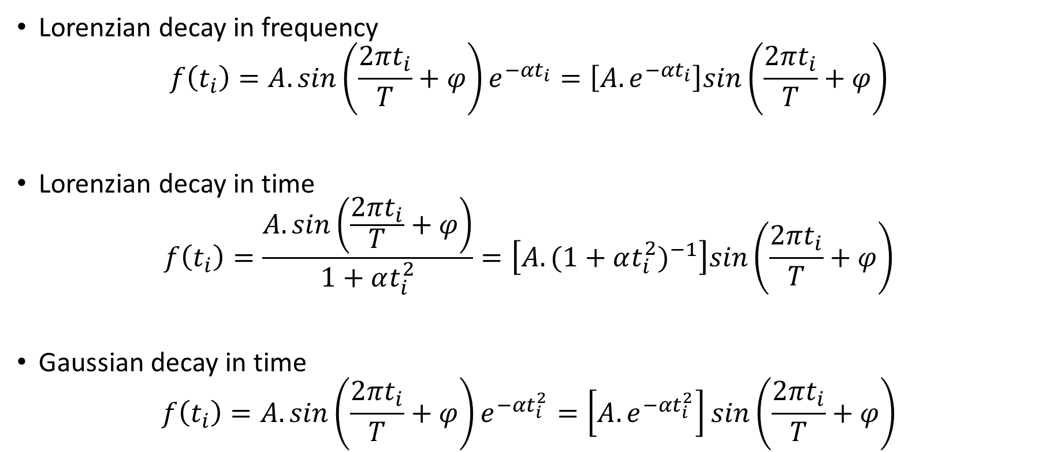
Decays
Lorenzian decay in frequency
$$f\left(t_{i}\right)=A.sin\left(\frac{2πt_{i}}{T}+φ\right)e^{−αt_{i}}=\left[A.e^{−αt_{i}}\right]sin\left(\frac{2πt_{i}}{T}+φ\right)$$
Lorenzian decay in time
$$f\left(t_{i}\right)=\frac{A.sin\left(\frac{2πt_{i}}{T}+φ\right)}{1+αt_{i}^{2}}=\left[A.{(1+αt_{i}^{2})}^{−1}\right]sin\left(\frac{2πt_{i}}{T}+φ\right)$$
Gaussian decay in time
$$f\left(t_{i}\right)=A.sin\left(\frac{2πt_{i}}{T}+φ\right)e^{−αt_{i}^{2}}=\left[A.e^{−αt_{i}^{2}}\right]sin\left(\frac{2πt_{i}}{T}+φ\right)$$

Slide 47
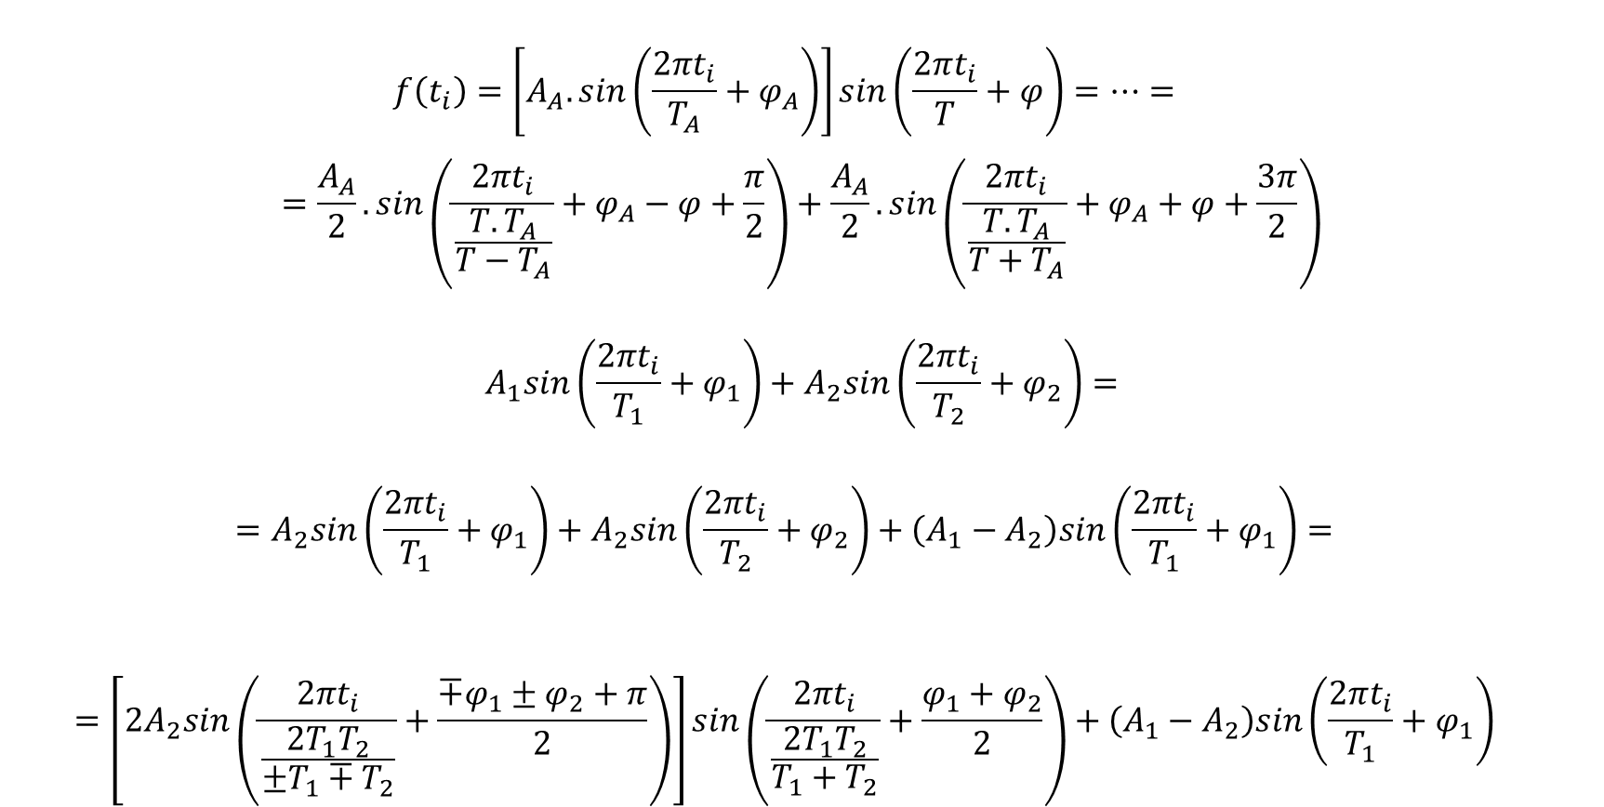
Decays
$$f\left(t_{i}\right)=\left[A_{A}.sin\left(\frac{2πt_{i}}{T_{A}}+φ_{A}\right)\right]sin\left(\frac{2πt_{i}}{T}+φ\right)=…=$$
$$=\frac{A_{A}}{2}.sin\left(\frac{2πt_{i}}{\frac{T.T_{A}}{T−T_{A}}}+φ_{A}−φ+\frac{π}{2}\right)+\frac{A_{A}}{2}.sin\left(\frac{2πt_{i}}{\frac{T.T_{A}}{T+T_{A}}}+φ_{A}+φ+\frac{3π}{2}\right)$$
$$A_{1}sin\left(\frac{2πt_{i}}{T_{1}}+φ_{1}\right)+A_{2}sin\left(\frac{2πt_{i}}{T_{2}}+φ_{2}\right)=$$
$$=A_{2}sin\left(\frac{2πt_{i}}{T_{1}}+φ_{1}\right)+A_{2}sin\left(\frac{2πt_{i}}{T_{2}}+φ_{2}\right)+\left(A_{1}−A_{2}\right)sin\left(\frac{2πt_{i}}{T_{1}}+φ_{1}\right)=$$
$$=\left[2A_{2}sin\left(\frac{2πt_{i}}{\frac{2T_{1}T_{2}}{±T_{1}∓T_{2}}}+\frac{∓φ_{1}±φ_{2}+π}{2}\right)\right]sin\left(\frac{2πt_{i}}{\frac{2T_{1}T_{2}}{T_{1}+T_{2}}}+\frac{φ_{1}+φ_{2}}{2}\right)+\left(A_{1}−A_{2}\right)sin\left(\frac{2πt_{i}}{T_{1}}+φ_{1}\right)$$

Slide 48

Decays
$$\left|\begin{aligned}\frac{T_{1}T_{2}}{{(t_{n}−t_{1}+1)(T}_{1}+T_{2})}<\frac{1}{3} \\ \frac{T_{1}+T_{2}}{\left|T_{1}−T_{2}\right|}>3 \\ \frac{T_{1}T_{2}}{\left|T_{1}−T_{2}\right|(t_{n}−t_{1}+1)}≫1\end{aligned}\right.$$

Slide 49

Bayesian periodogram analysis
$$f\left(t_{i}\right)=\sum_{j=1}^{w}{\left(a_{1j}cos\frac{2πt_{i}}{T_{1j}}{+b}_{1j}sin\frac{2πt_{i}}{T_{1j}}+a_{2j}cos\frac{2πt_{i}}{T_{2j}}{+b}_{2j}sin\frac{2πt_{i}}{T_{2j}}\right)}$$
$$f\left(t_{i}\right)=\sum_{j=1}^{w}{\left[A_{1j}sin\left(\frac{2πt_{i}}{T_{1j}}+φ_{1j}\right)+A_{2j}sin\left(\frac{2πt_{i}}{T_{2j}}+φ_{2j}\right)\right]}$$
$$f\left(t_{i}\right)=\sum_{j=1}^{w}{\left[A_{1j}sin\frac{2π{(t}_{i}−t_{0,1j})}{T_{1j}}+A_{2j}sin\frac{2π{(t}_{i}−t_{0,2j})}{T_{2j}}\right]}$$

Slide 50

Confidence intervals of forecast
$$P\left({\hat{f}}_{i} | f_{i}I\right)=\frac{C_{{\hat{f}}_{1}}^{f_{1}}C_{{\hat{f}}_{2}}^{f_{2}}…C_{{\hat{f}}_{m}}^{f_{m}}}{C_{N+m−1}^{N−n}}$$
$$N=n+1$$
$${\hat{f}}_{k}=f_{k}+1$$
$${\hat{f}}_{i}=f_{i};i≠k$$
$$P\left({\hat{f}}_{i} | f_{i}I\right)=\frac{C_{f_{1}}^{f_{1}}C_{f_{2}}^{f_{2}}…C_{f_{k}+1}^{f_{k}}{…C}_{f_{m}}^{f_{m}}}{C_{n+1+m−1}^{n+1−n}}=\frac{C_{f_{k}+1}^{f_{k}}}{C_{n+m}^{1}}=\frac{f_{k}+1}{n+m}$$

Slide 51

Confidence intervals of forecast
$$\frac{f_{2}+1}{n+3}=P$$
$$f_{2}=P\left(n+3\right)−1$$
$$\frac{f_{1,3}+1}{n+3}=\frac{1−P}{2}$$
$$f_{1,3}=\frac{1−P}{2}\left(n+3\right)−1$$

Slide 52

Confidence intervals of forecast
$$ε_{\left\lfloor f_{1}\right\rfloor }≤ε_{LL}≤ε_{\left\lfloor f_{1}\right\rfloor +1}$$
$$ε_{LL}=ε_{\left\lfloor f_{1}\right\rfloor }+\left(ε_{\left\lfloor f_{1}\right\rfloor +1}−ε_{\left\lfloor f_{1}\right\rfloor }\right)\left(f_{1}−\left\lfloor f_{1}\right\rfloor \right)$$
$$y_{n+i,LL}=f\left(t_{n+i}\right)+ε_{LL}$$
$$ε_{n−\left\lfloor f_{3}\right\rfloor }≤ε_{UL}≤ε_{n−\left\lfloor f_{3}\right\rfloor +1}$$
$$ε_{UL}=ε_{n−\left\lfloor f_{3}\right\rfloor +1}−\left(ε_{n−\left\lfloor f_{3}\right\rfloor +1}−ε_{n−\left\lfloor f_{3}\right\rfloor }\right)\left(f_{3}−\left\lfloor f_{3}\right\rfloor \right)$$
$$y_{n+i,UL}=f\left(t_{n+i}\right)+ε_{UL}$$

Slide 53
References
Атанасов, А. 2018. Статистически методи за анализ на динамични редове. София: Издателски комплекс – УНСС
Величкова, Н. 1981. Статистически методи за изучаване и прогнозиране развитието на социално-икономическите явления. София: „Наука и изкуство“
Харалампиев, К. Бейсовски подход за оценка на хармонични колебания с променлива амплитуда. Научна конференция с международно участие „Авангардни научни инструменти в управлението”, Равда, 2014
Bretthorst, G., 1988. Bayesian Spectrum Analysis and Parameter Estimation. Berlin, Heidelberg: Springer-Verlag
Schwarz, G. 1978. Estimating the Dimension of a Model. The Annals of Statistics, Vol. 6, No. 2, 461-464
Stone, M. 1977. An Asymptotic Equivalence of Choice of Model by Cross-Validation and Akaike’s Criterion. Journal of the Royal Statistical Society. Series B (Methodological) , 1977, Vol. 39, No. 1 (1977), pp. 44-47
Stone, M. 1979. Comments on Model Selection Criteria of Akaike and Schwarz. Journal of the Royal Statistical Society. Series B (Methodological) , 1979, Vol. 41, No. 2 (1979), pp. 276-278

